Slide 1
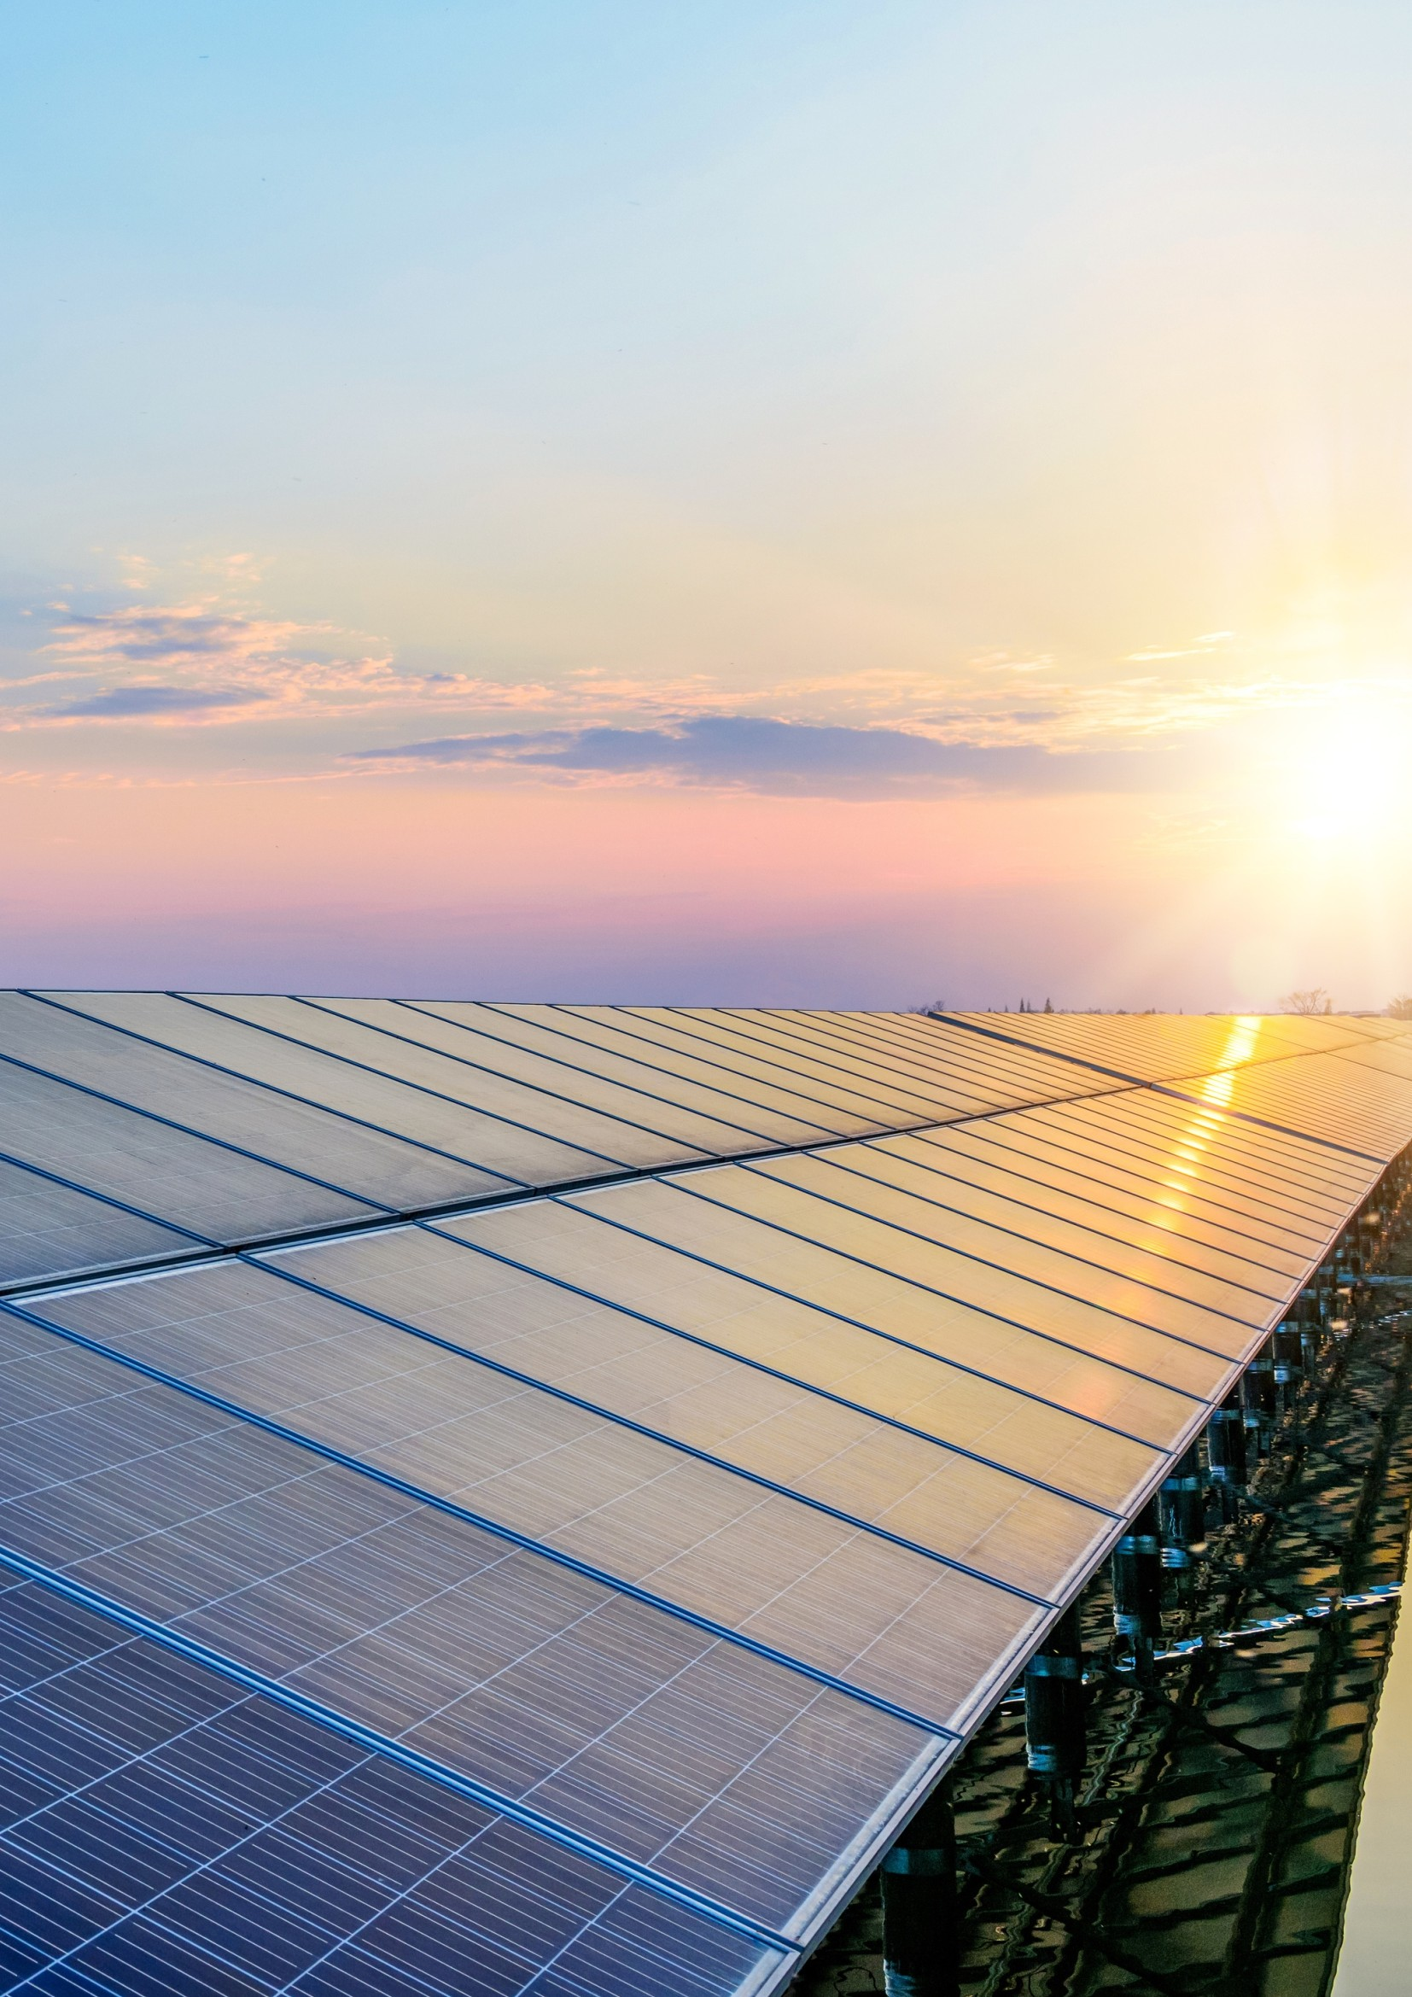
SMART SOLUTIONS
For Sustainable Future

Slide 2
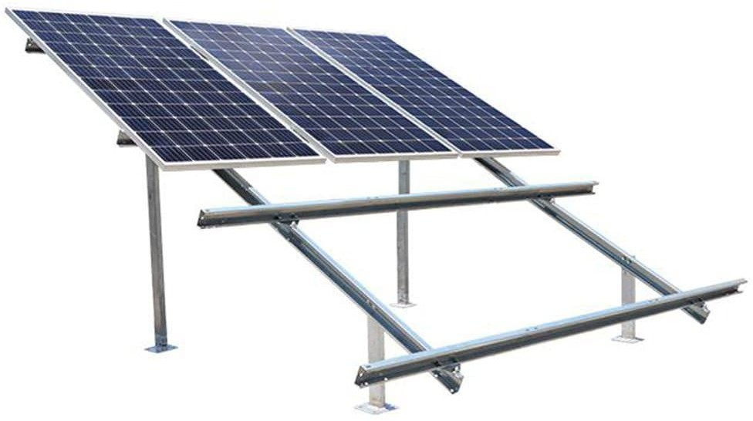
What is Solar Energy ?
Solar energy is radiant light and heat from the Sun that is harnessed using a range of technologies such as solar power to generate electricity, solar thermal energy including solar water heating, and solar architecture.
It is an essential source of renewable energy, and its technologies are broadly characterized as either passive solar or active solar depending on how they capture and distribute solar energy or convert it into solar power. Active solar techniques include the use of photovoltaic systems, concentrated solar power, and solar water heating to harness the energy. Passive solar techniques include orienting a building to the Sun, selecting materials with favourable thermal mass or light-dispersing properties, and designing spaces that naturally circulate air.
Why Solar Energy ?
Environmental concerns/reduce carbon emissions
Save money on electric bills
General interest in new technologies
Increase in home value
SMART SOLUTIONS
For Sustainable Future

Slide 3
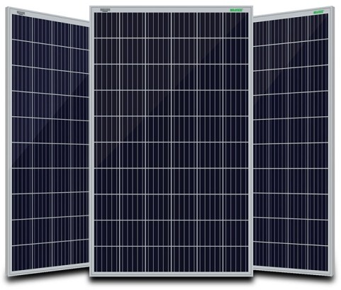




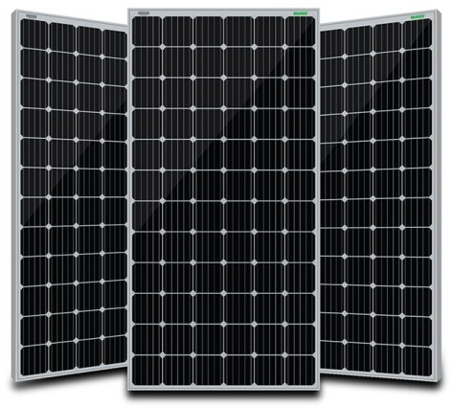




Types of Solar Modules
POLYCRYSTALLINE
Superior module efciency as per international benchmarks
1500 VDC system voltage for lower BoS cost
Glass with anti reective coating improves light transmission
Salt mist, blowing sand and hail resistant
PID resistant with long term reliability
Sustain heavy wind & snow loads (2400 pa & 5400 pa)
MONOCRYSTALLINE
Superior module efciency as per international benchmarks
IP 67 rated MC4 compatible connectors
Glass with anti reective coating improves light transmission
Salt mist, blowing sand and hail resistant
PID resistant with long term reliability
Sustain heavy wind & snow loads (2400 pa & 5400 pa)

Slide 4
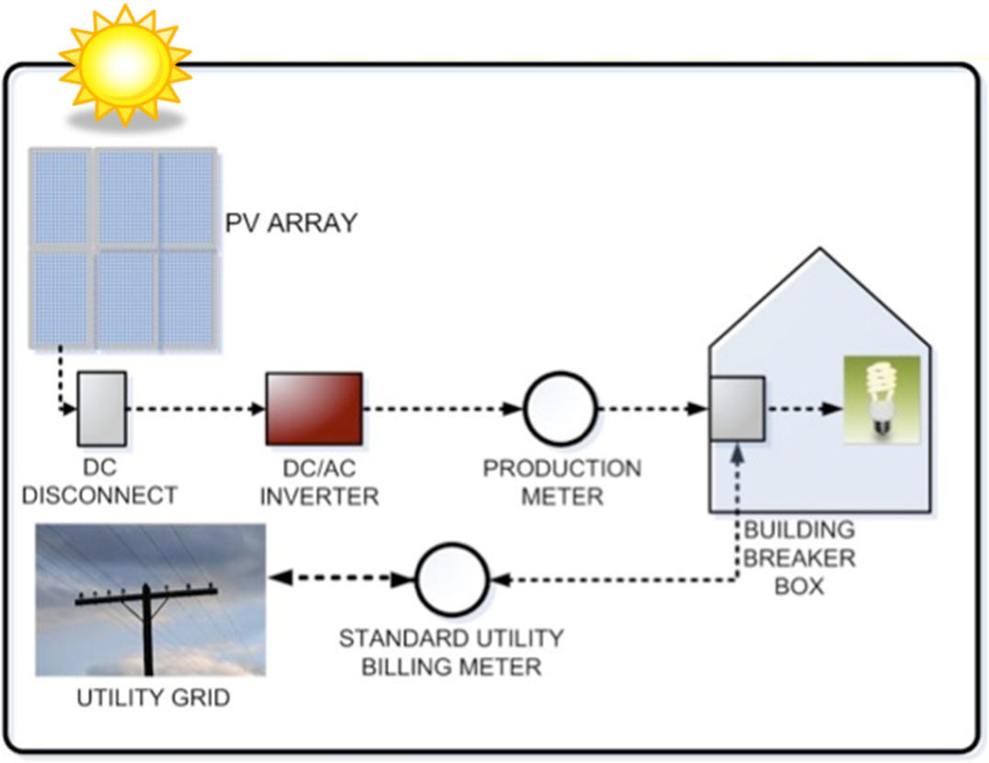
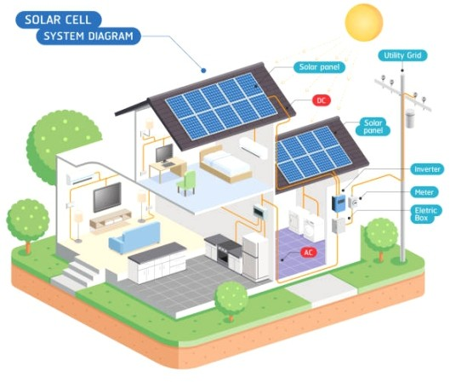
Solar Power Generation System
Beneﬁts of Solar Power
Increased home values
Longer warranties
No moving parts
Low maintenance (Inverter replacement) Ÿ Unlimited resource / free fuel (the sun!) Ÿ Creates local jobs
Low interest loans are available
SMART SOLUTIONS
For Sustainable Future

Slide 5
List of Equipments
Inverter
Battery
Solar Panel
Charger Controller
Structure
Wires & Cables
Cost per KW for Solar Generation

Slide 6
Payback Period
Warranty / Guarantee
SMART SOLUTIONS
For Sustainable Future

Slide 7






Our EPC Partner
Ÿ PR SOLAR AND INFRA ENTERPRISES
Our Solar Module and Other Equipment Partner
“We are like tenant farmers chopping down the fence around our house for fuel when we should be using Natures inexhaustible sources of energy – sun, wind and tide. … I’d put my money on the sun and solar energy. What a source of power! I hope we don’t have to wait until oil and coal run out before we tackle that.”

Slide 8
SMART SOLUTIONS
For Sustainable Future
120/500 12, lajpat nagar, Kanpur Nagar - 208 005, Uttar Pradesh, Mob: +91-87264 94776

Slide 9
SMART SOLUTIONS
INDEX
SR. NO. | TOPIC | PAGE NO.
1 | Solar Panel
2 | Solar Inverter
3 | Miscellaneous Items
4 | Structure
5 | Layout & Foundation
6 | Warranties
7 | Do's & Don’ts
8 | Consultants Details
i | Himtech Consultants Pvt. Ltd,
ii | Work Executed
iii | Pictures of work executed
9 | Stadd pro sample reports

